Slide 1
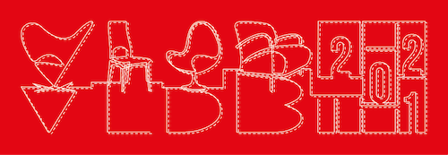
Scaling Attributed Network Embedding to Massive Graphs
by: R. Yang, J. Shi, X. Xiao, Y. Yang, J. Liu, and S. Bhowmick
Notes:
Hello everyone, welcome to my presentation. My name is Renchi and I am a Research Fellow at NUS. Next, I will introduce our work, Scaling Attributed Network Embedding to Massive Graphs.

Slide 2
Basic data analytics is easy.
Attributes
X₁
X₂
X₃
X₄
Y?
Stock | Profit | Revenue | Market share | Overvalued? | Buy?
TSLA | $721m | $31B | 3.6% | Yes | ???
Target attribute

Slide 3
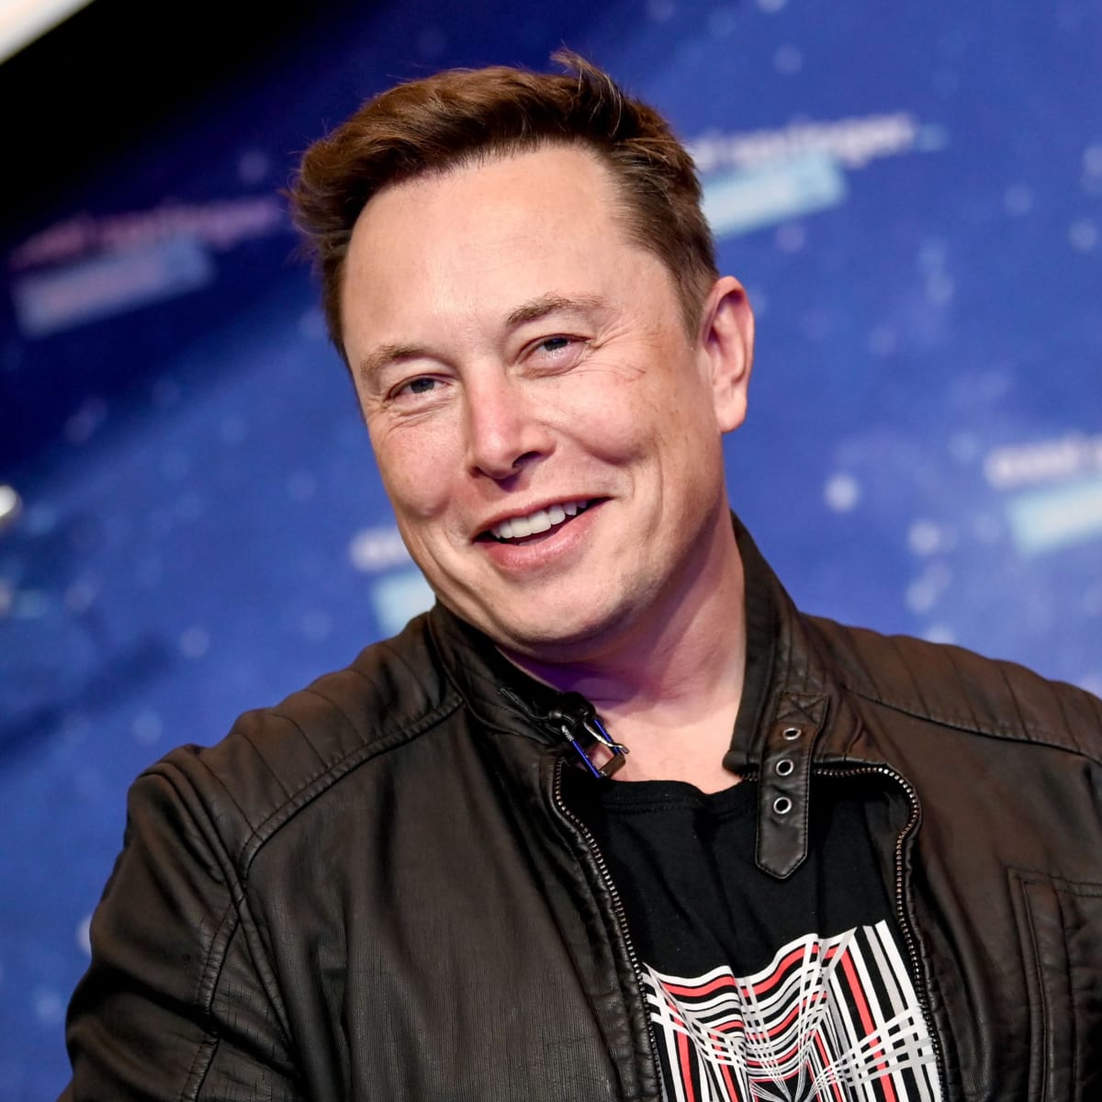
Graph data analytics is more powerful.
X1 | X2 | X3 | X4 | X5
$$$ | $$$ | $$$ | $$$ | $$$
X1 | X2 | X3 | X4 | X5
$$$ | $$$ | $$$ | $$$ | $$$
X1 | X2 | X3 | X4 | X5
$$$ | $$$ | $$$ | $$$ | $$$
X1 | X2 | X3 | X4 | X5
$$$ | $$$ | $$$ | $$$ | $$$
Stock | Profit | Revenue | Market share | Overvalued? | Buy?
TSLA | $721m | $31B | 3.6% | Yes | ???
X1 | X2 | X3 | X4 | X5
$$$ | $$$ | $$$ | $$$ | $$$
X1 | X2 | X3 | X4 | X5
$$$ | $$$ | $$$ | $$$ | $$$

Slide 4
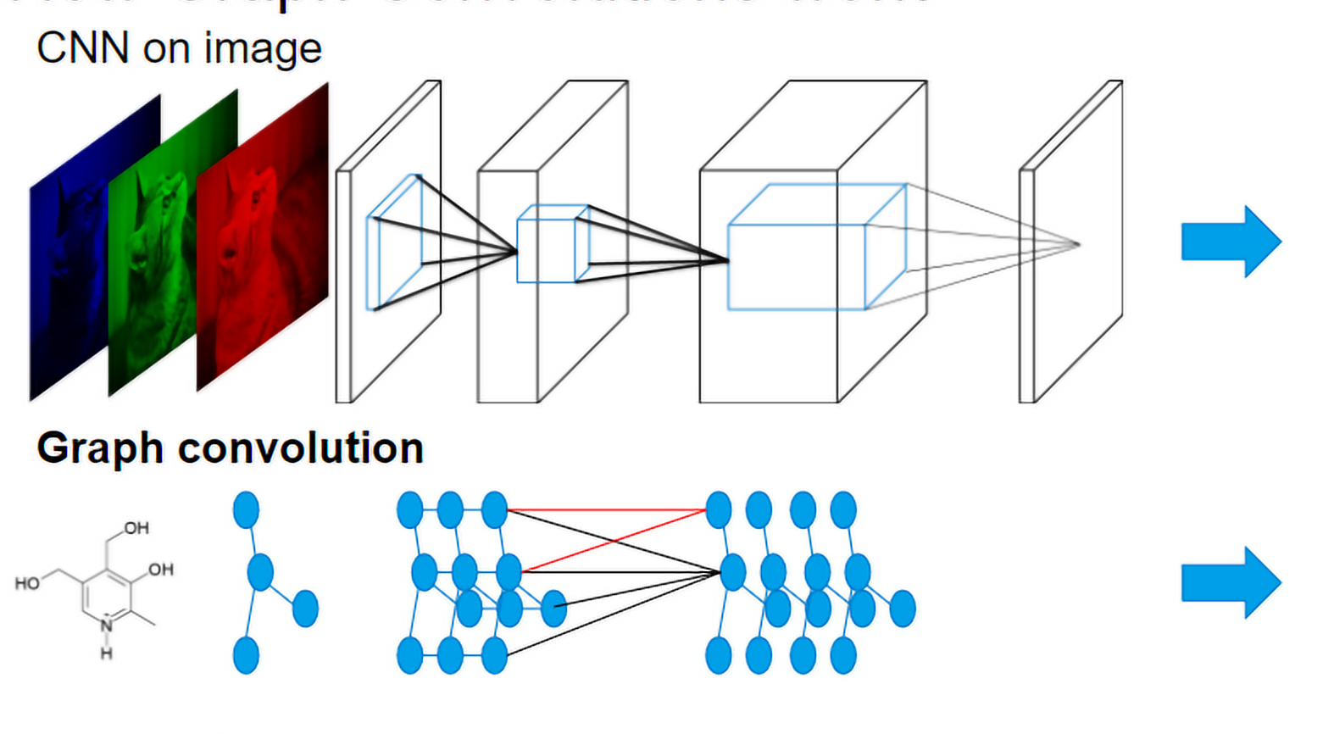
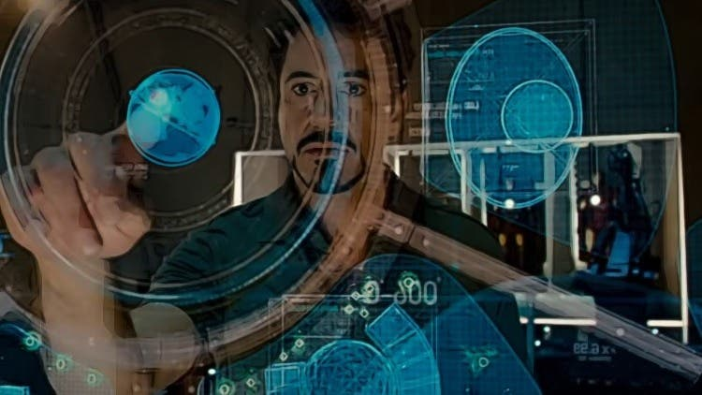
Graph data analytics is powerful but difficult.
Single table data analytics
Attributed graph data analytics
Deep graph
neural network
Tools
Difficulty
Req. Skill level

Slide 5
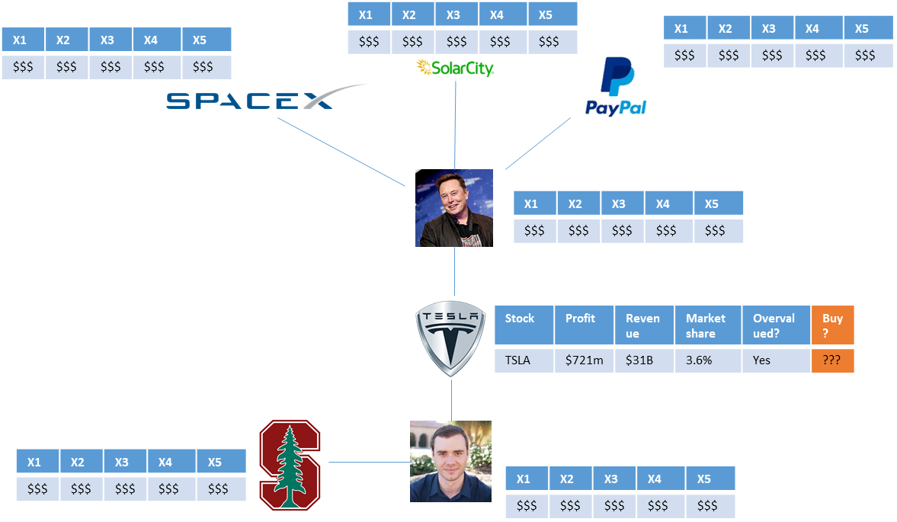
We present Practical Attributed Network Embedding (PANE).
Embedding vector
PANE
X1 | X2 | X3 | X4 | … | X30 | X31 | X32 | Buy?
0.12 | 0.34 | 0.56 | 0.78 | … | 0.101 | 0.223 | 0.334 | ???
Attributed graph data analytics
Embedding vector data analytics

Slide 6
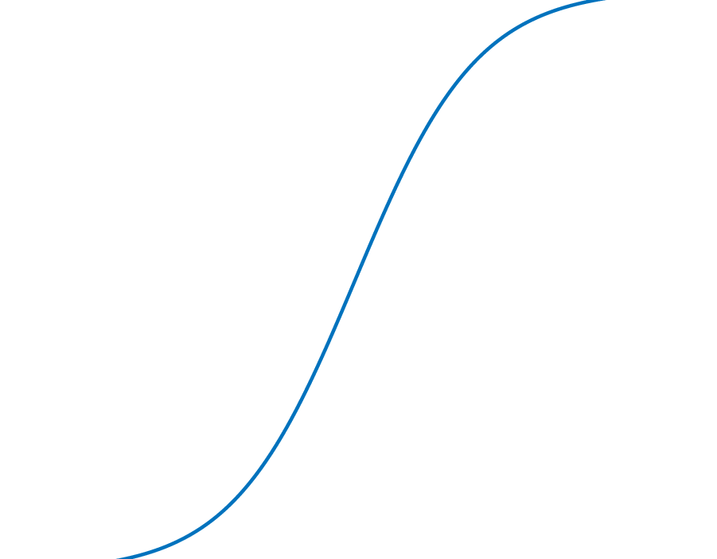
Performance of PANE
Computing all embeddings on a HUGE graph with 59m nodes,
0.98b edges, 2k attributes
Effective
Accuracy (F1):
_{up to} +17.2%
Single-server:
~ 12 hours
Compared to SOTA
Neural Network methods
Efficient

Slide 7
Applications of PANE
?
Link Prediction
Attribute Inference
Node Classification

Slide 8
PANE is based on mostly novel database technologies (with a bit of machine learning flavor).
1
PANE measures Node-Attribute affinity via random walks.
2
PANE computes embeddings with joint matrix factorization.
3
PANE makes full use of multi-core parallel computation.

Slide 9
Types of Random Walks in PANE
1
$$u$$
attribute $r$
attribute $r$
$$v$$
Forward: node-to-attribute
Backward: attribute-to-node
Notes:
In addition to the random walk that goes from a node to an attribute,
[click]
we also define a type of random walk that goes from an attribute to a node and will explain why we do this.

Slide 10
Forward Random Walks
1
Forward random walk from node $u$:
Start from $u$
At each step, stop with $α$ probability
After stopping at a node $v$, pick an attribute $r$ with probability $∝w(v,r)$
Intuition: it samples an attribute $r$ from the vicinity of $u$
attribute $r$
$v$
stop
$u$
stop?
stop?
Notes:
Let me fist explain the random walks that we use.
[click]
[click]
Given a source node u, a node-to-attribute random walk starts from u and jumps to an out-neighbor of the current node or stops with alpha probability at the current node. Once it stopped, it picks an attribute r of the current node according to the weight of the node-attribute association.
[click]
The intuition here is that the random walk samples an attribute r from the neighborhood of node u. If r appears frequently in the neighborhood of u, then it has a higher probability to be sampled. Intuitively, such an attribute r has a strong relationship with u.

Slide 11
Node-Attribute Affinity
1
Node-attribute affinity:
$F\left[u,r\right]=$ normalized probability that a forward random walk from $u$ samples $r$ in the end
attribute $r$
$v$
stop
$u$
stop?
stop?
Notes:
Based on the above notion of random walks, we define the node-attribute affinity F[u,r] between a node u and an attribute r as the normalized probability of these node-to-attribute random walks.

Slide 12
Backward RW & Attribute-Node Affinity
1
Backward random walk from attribute $r$
Randomly pick a node $s$ with probability proportional to the weight of $(s,r)$
Start a random walk from $s$
At each step, stop with $α$ probability
Let $v$ be the stopping point of the walk
Attribute-node affinity
$B\left[r,v\right]←$ normalized random walk probability from attribute $r$ to node $v$
attribute $r$
stop?
$s$
$v$
stop?
stop
Notes:
[click,click]
The attribute-to-node random walk from an attribute r first picks a node s having attribute r according to the weight of their association, and then starts a random walk from s until terminating at a node v.
[click]
The intuition here is if a node v has a strong connection to an attribute r, then the random walk from r has a relatively high probability to sample v.
[click]
Based on this notion of random walks, we define the attribute-node affinity B[r,v] between node v and attribute r as the normalized probability that an attribute-to-node random walk from attribute r ending at node v.

Slide 13
Node-to-Node affinity is derived.
1
$$p\left(u,v\right)=\sum_{r∈R}{F\left[u,r\right]⋅B\left[r,v\right]}$$
$$u$$
$$v$$
attribute $r$
This saves a LOT of space: $O\left(n^{2}\right)→O\left(nd\right), d≪n$
Notes:
So why do we define a node-attribute affinity as well as an attribute-node affinity?
The reason is that we can combine these two affinities to implicitly model the affinity between nodes.
[click, click]
Intuitively, if we have a random walk that goes from a node u to an attribute r, and we have another random walk that goes from r to another node v, then the combination (kɒmbɪˈneɪʃ(ə)n) of these two random walks can be regarded as a random walk from u to v, with a teleport in the middle.

Slide 14
Embedding Matrices in PANE
2
We construct
two embedding matrices $X_{f}$ and $X_{b}$ for the nodes, and
one embedding matrix $Y$ for attributes
Optimization objective:
$X_{f}⋅Y^{⊤}≈F$, to capture node-attribute affinity
$Y⋅X_{b}^{⊤}≈B$, to capture attribute-node affinity
$$Y^{⊤}$$
$$⋅$$
$$X_{f}$$
$$≈$$
for $u$
for $r$
$F[u,r]$
$$X_{b}$$
$$⋅$$
$$Y$$
$$≈$$
for $r$
for $v$
$B[r,v]$
Notes:
Now the question is, how can we construct embeddings to capture the affinity measurements that we just mentioned? The idea is as follows.
[click]
We aim to construct a forward embedding matrix Xf and a backward embedding matrix Xb for nodes and an embedding matrix Y for attributes.
[click，click] Such that Xf and Y can reconstruct node-attribute affinities, Xb and Y can capture attribute-node affinities.

Slide 15
Solving the optimization program
2
Jointly factorize $F$ and $B$ to obtain $X_{f}$, $X_{b}$, and $Y$
Formulate the joint factorization as a least square problem
Solve it using gradient descent
Use randomized SVD to obtain a good initial solution
Time complexity: $O(mdt+ndkt)$
$k$ is the embedding size
$t$ is the number of iterations
($t=5$ in our experiments)
$$Y^{⊤}$$
$$⋅$$
$$X_{f}$$
$$≈$$
for $u$
for $r$
$F[u,r]$
$$X_{b}$$
$$⋅$$
$$Y$$
$$≈$$
for $r$
for $v$
$B[r,v]$
Notes:
Let n be the number of nodes, d be the number of attributes, m be the number of edges.
The construction of the two affinity matrices takes only O(nd) space and O(md) time
Then we jointly factorize F and B to obtain the embedding matrices.

Slide 16
Greedy Initialization + SGD
2
$F≈U∙Σ∙V^{T}$
$X_{f}=U∙Σ, Y=V$
$\text{V}\text{=}\text{Y} \text{is} \text{unitary}$
$Y^{T}∙Y=I$
$X_{b}=X_{b}Y^{T}Y=B∙Y$
For $t$ iterations:
Update $X_{f}, X_{b}$ via SGD;
Update $Y$ via SGD;
$$F$$
$$≈$$
$$X_{f}$$
$$∙$$
$$Y$$
$$B$$
$$≈$$
$$X_{b}$$
$$∙$$
$$Y$$
Greedy initialization of embeddings via randomized SVD and the unitary property
Only a few iterations are needed!

Slide 17
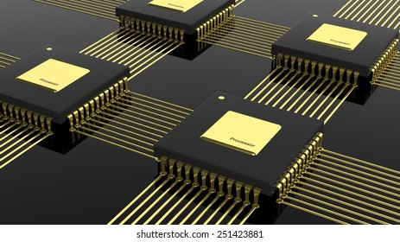
PANE is fully parallelized on multi-core computers.
3
Explained in Section 4 of our paper.

Slide 18
Experiments: 8 Datasets
Name | # of nodes | # of edges | # of distinct attributes | # of attributes per node | # of distinct labels
Cora | 2.7k | 5.4k | 1.4k | 18.2 | 7
Citeseer | 3.3k | 4.7k | 3.7k | 31.9 | 6
Facebook | 4k | 88.2k | 1.3k | 8.3 | 193
Pubmed | 19.7k | 44.3k | 0.5k | 50.2 | 3
Flickr | 7.6k | 479.5k | 12.1k | 24.0 | 9
Google+ | 107.6k | 13.7M | 15.9k | 2793.7 | 468
TWeibo | 2.3M | 50.7M | 1.7k | 7.3 | 8
MAG | 59.3M | 978.2M | 2.0k | 7.3 | 100
Notes:
In our experiments, we use 8 datasets, with up to 50 million nodes and almost 1 billion edges.

Slide 19
Experiments: 10 Competitors
Default embedding dimensionality: $k=128$
6 neural-network-based methods
STNE [KDD 2018]
ARGA [IJCAI 2018]
LQANR [IJCAI 2019]
CAN [WSDM 2019]
DGI [ICLR 2019]
GATNE [KDD 2019]
3 factorization-based methods
TADW [IJCAI 2015]
BANE [ICDM 2018]
NRP [VLDB 2020]
1 other method
PRRE [CIKM 2018]
Notes:
We compare our proposed PANE method against 6 neural-network-based methods, three matrix factorization-based methods and one other method.
We set the embedding dimensionality to 128, which is a common setting in the literature.

Slide 20
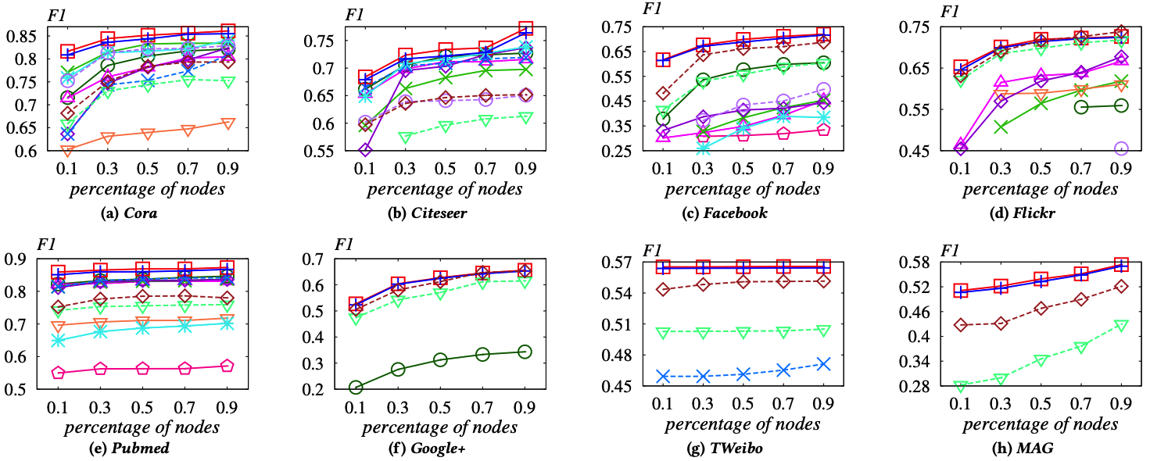
Results: Node Classification
Percentage of nodes used for training: 10% ~ 90%
PANE vs. SOTA: improvements of 3.4%-17.2% in terms of F1 measure
Notes:
Here are the results for the node classification tasks performed using the embeddings generated by each method.
The x-axes of these figures represent the percentages of nodes used for training, the y-axes represent the F one scores.
Overall, the F1 score of our solution is higher than the state of the art by three point four percent to seventeen point two percent

Slide 21
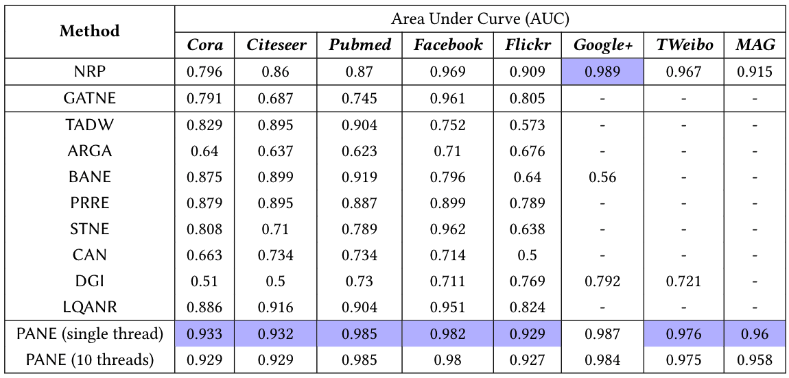
Results: Link Prediction
From the same first author.
Notes:
Here are the results for the link prediction task. The table here shows the performance of each method for link prediction, measured by the area under the curve, or AUC for short.
The AUC of our solution is 0.9% to 6.6% higher than the state of the art in almost all cases.
The only exception is on the Google+ dataset, where our solution is outperformed by a competing method by a very small margin.

Slide 22
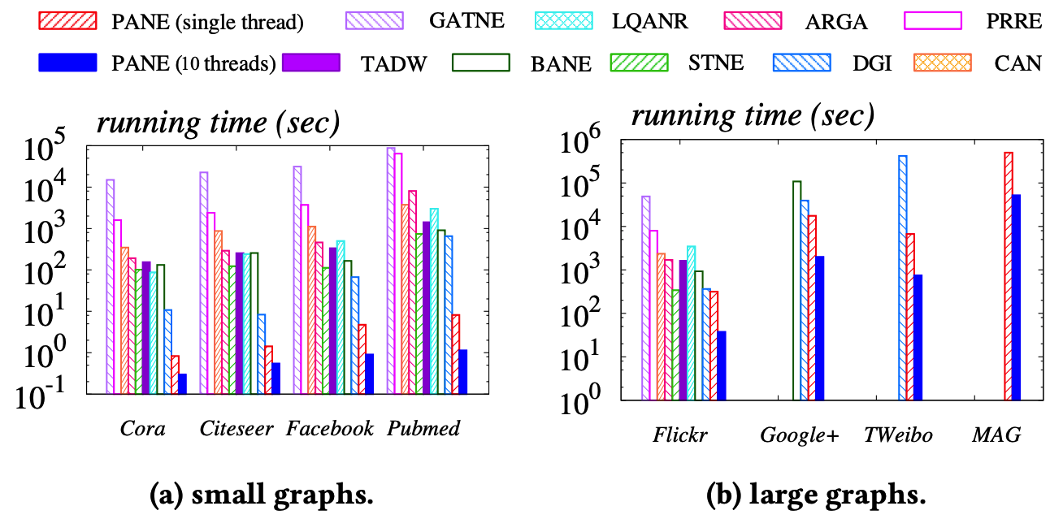
Results: Efficiency
Compared to the state of the art, PANE is orders of magnitude faster
On the MAG dataset with 0.98 billion edges, PANE can terminate within 12 hours using 10 CPU cores (Intel Xeon 2.2GHz)
Notes:
In the next set of experiments, we measure the running time of each method on all datasets. The Y-axes here represent the running time in log scale.
In general, our solution is orders of magnitude faster than competing methods. Even on this largest dataset with close to 1 billion edges, our solution can terminate within 12 hours using 10 threads.

Slide 23
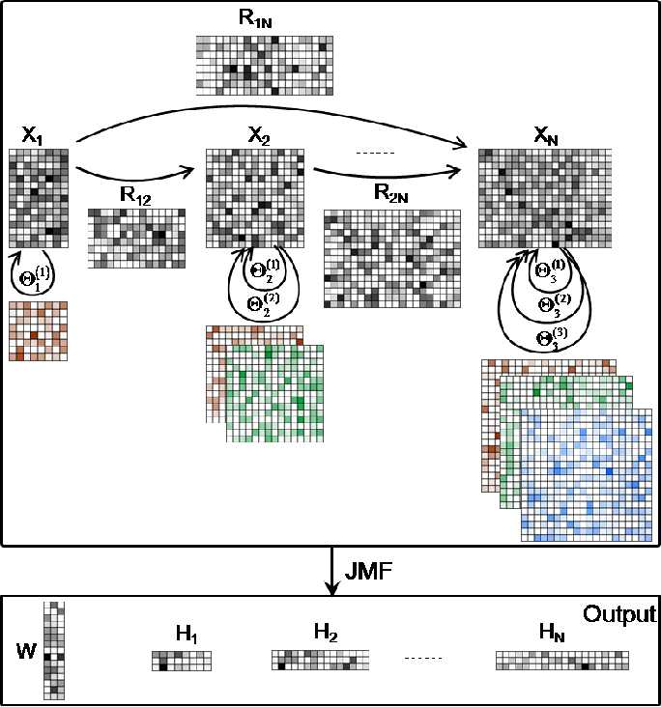
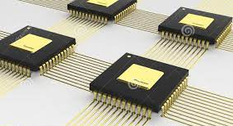
THANK YOU
PANE
1
2
3
Parallelization
Random walks
Joint matrix factorization
Notes:
Thanks.

Slide 24
Backup Slides

Slide 25
PANE: Objective
2
Derive forward & backward node embeddings $X_{f},X_{b}$ & attribute embeddings $Y$ such that
$$X_{f}$$
$$×$$
$$Y$$
$$×$$
$$X_{b}$$
$$≈$$
$$≈$$
Using SVD is infeasible
Using SGD is expensive
attribute-to-node affinity
node-to-attribute affinity
$$F$$
$$B$$

