Slide 1
Differential Privacy
SIGMOD 2012 Tutorial
Part 1: Motivation
Marianne Winslett
University of Illinois at Urbana-Champaign
Advanced Digital Sciences Center, Singapore
Including slides from:
Anupam Datta / Yufei Tao / Tiancheng Li / Vitaly Smatikov / Avrim Blum / Johannes Gehrke / Gerome Miklau / & more!

Slide 2
Why should we care?
Official outline:
Overview of privacy concerns
Case study: Netflix data
Case study: genomic data (GWAS)
Case study: social network data
Limits of k-anonymity, l-diversity, t-closeness
Part 1A

Slide 3
Many important applications involve publishing sensitive data about individuals.
Medical research
  What treatments have the best outcomes?
  How can we recognize the onset of disease earlier?
  Are certain drugs better for certain phenotypes?
Web search
  What are people really looking for when they search?
  How can we give them the most authoritative answers?
Public health
  Where are our outbreaks of unpleasant diseases?
  What behavior patterns or patient characteristics are correlated with these diseases?

Slide 4
Many important applications involve publishing sensitive data about individuals.
Urban planning
  Where do people live, work, and play, e.g., as tracked by their phone’s GPS?
  How do they travel between those places, e.g., via foot, bus, train, taxi, car? What is their travel experience, e.g., how much time do they spend waiting for transport or stuck in traffic?
Energy conservation
  How much energy do households/offices use at each time of day?
  How could the peak loads associated with this behavior be changed, e.g., by smart appliances and demand response, so that we can build fewer power plants?

Slide 5
Many important applications involve publishing sensitive data about individuals.
Social and computer networking
  What is the pattern of phone/data/multimedia network usage? How can we better use existing (or plan new) infrastructure to handle this traffic?
  How do people relate to one another, e.g., as mediated by Facebook?
  How is society evolving (Census data)?
Industrial data (individual = company; need SMC if no TTP)
  What were the total sales, over all companies, in a sector last year/quarter/month?
  What were the characteristics of those sales: who were the buyers, how large were the purchases, etc.?

Slide 6
Today, access to these data sets is usually strictly controlled.
Only available:
Inside the company/agency that collected the data
Or after signing a legal contract
  Click streams, taxi data
Or in very coarse-grained summaries
  Public health
Or after a very long wait
  US Census data details
Or with definite privacy issues
  US Census reports, the AOL click stream, old NIH dbGaP summary tables, Enron email
Or with IRB (Institutional Review Board) approval
  dbGaP summary tables
Society would benefit if we could publish some useful form of the data, without having to worry about privacy.

Slide 7
Why is access so strictly controlled?
  No one should learn who had which disease.
“Microdata”

Slide 8
What if we “de-identify” the records by removing names?
publish

Slide 9
We can re-identify people, absolutely or probabilistically, by linking with external data.
The published table
A voter registration list
Quasi-identifier (QI) attributes
“Background knowledge”

Slide 10
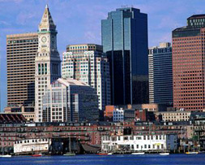
87% of Americans can be uniquely identified by {zip code, gender, date of birth}.
actually 63%
[Golle 06]
Latanya Sweeney [International Journal on Uncertainty, Fuzziness and Knowledge-based Systems, 2002] used this approach to re-identify the medical record of an ex-governor of Massachusetts.

Slide 11
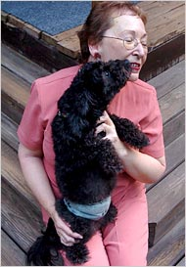
Real query logs can be very useful to CS researchers. But click history can uniquely identify a person.
<AnonID, Query, QueryTime, ItemRank, domain name clicked>
What the New York Times did:
  Find all log entries for AOL user 4417749
  Multiple queries for businesses and services in Lilburn, GA (population 11K)
  Several queries for Jarrett Arnold
    Lilburn has 14 people with the last name Arnold
  NYT contacts them, finds out AOL User 4417749 is Thelma Arnold

Slide 12
Just because data looks hard to re-identify, doesn’t mean it is.
[Narayanan and Shmatikov, Oakland 08]
In 2009, the Netflix movie rental service offered a $1,000,000 prize for improving their movie recommendation service.
Training data: ~100M ratings of 18K movies from ~500K randomly selected customers, plus dates
Only 10% of their data; slightly perturbed
 | High School Musical 1 | High School Musical 2 | High School Musical 3 | Twilight
Customer #1 | 4 | 5 | 5 | ?

Slide 13
We can re-identify a Netflix rater if we know just a little bit about her (from life, IMDB ratings, blogs, …).
8 movie ratings (≤ 2 wrong, dates ±2 weeks) ➔ re-identify 99% of raters
2 ratings, ±3 days ➔ re-identify 68% of raters
  Relatively few candidates for the other 32% (especially with movies outside the top 100)
Even a handful of IMDB comments allows Netflix re-identification, in many cases
  50 IMDB users → re-identify 2 with very high probability, one from ratings, one from dates

Slide 14
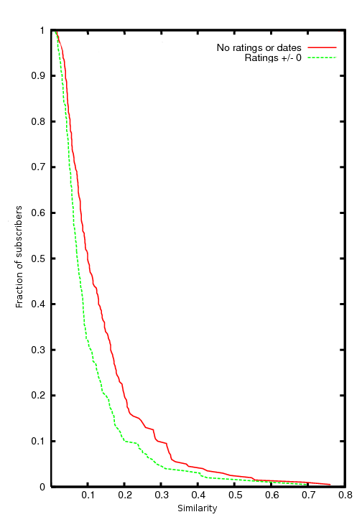
The Netflix attack works because the data are sparse and dissimilar, with a long tail.
Considering just movies rated, for 90% of records there isn’t a single other record that is more than 30% similar

Slide 15
Why should we care about this innocuous data set?
All movie ratings → political and religious opinions, sexual orientation, …
Everything bought in a store → private life details
Every doctor visit → private life details
“One customer … sued Netflix, saying she thought her rental history could reveal that she was a lesbian before she was ready to tell everyone.”

Slide 16

Social networks also describe relationships between people, which can be sensitive too.
Nodes
Edges
ID | Age | HIV
Alice | 25 | Pos
Bob | 19 | Neg
Carol | 34 | Pos
Dave | 45 | Pos
Ed | 32 | Neg
Fred | 28 | Neg
Greg | 54 | Pos
Harry | 49 | Neg
ID1 | ID2
Alice | Bob
Bob | Carol
Bob | Dave
Bob | Ed
Dave | Ed
Dave | Fred
Dave | Greg
Ed | Greg
Ed | Harry
Fred | Greg
Greg | Harry
Edges from call & email logs: what did they know and when did they know it?
Notes:
Most work on privacy concerns the Node table, in which sensitive facts about each entity may be present.
The distinctive feature of network data is the Edge table, representing relationships, associations, transactions. Edges could have attributes too.
Sensitive aspects of network data:
Edges may be sensitive facts. Implied properties of the edge table may be sensitive: degree, or other structural features. Structural features combined with attributes: most of Bob’s friends are over 30.

Slide 17
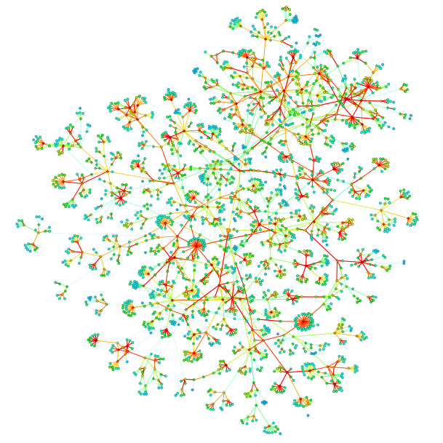
We could learn so much about how society works if we could freely analyze these data sets.
J. Onnela et al.
Structure and tie strengths in mobile communication networks,
Proceedings of the National Academy of Sciences, 2007
Notes:
Now, social network data is collected through the electronic traces of our activities. New networks are observable, the scale of network data is growing rapidly.
The strength of social ties in a mobile phone network, robustness to removals of ties, and implications for information diffusion in the societal network.

Slide 18
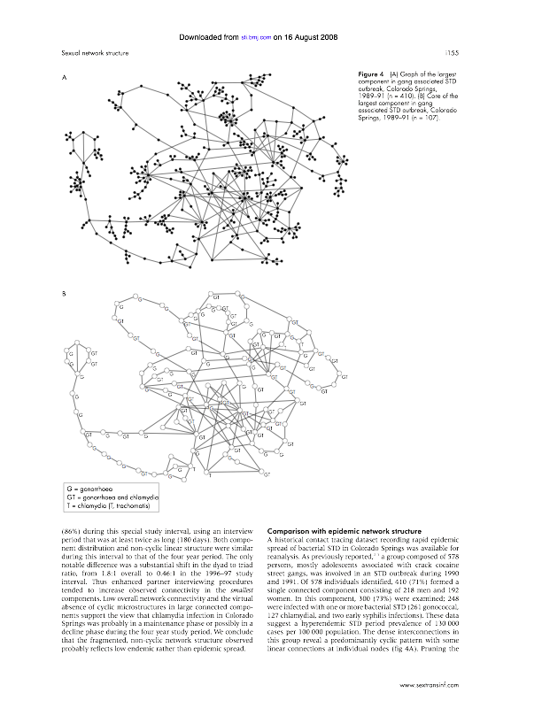
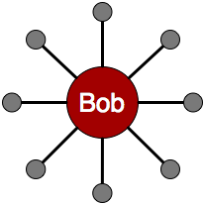
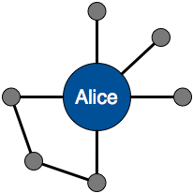
But de-identified people (nodes) can still be re-identified using background info.
Naively Anonymized Network
External information
18
Notes:
The problem with naive anonymization is that re-identification of nodes is possible if an adversary has some external information about named individuals. For example, if I am able to learn (through an outside source) that the structure of Bob looks like this ... then
Unique v. approximate re-identification
Dual re-identification can reveal edges

Slide 19
In fact, local structure is highly identifying.
Friendster network
~4.5 million nodes
Well-protected
Uniquely identified
degree
nbrs degree
[Hay, VLDB 08]

Slide 20
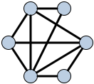
The reidentification attack can also be active.
Active attack
Embed small random graph prior to anonymization.
[Backstrom,
WWW 07]
Auxiliary network attack
Wherefore Art Thou R3579X? Anonymized Social Networks, Hidden Patterns, and Structural Steganography.
Backstrom, Dwork, and Kleinberg. WWW 2007
Use unanonymized public network with overlapping membership.
[Narayanan,
OAKL 09]
Notes:
Another attack was proposed by Backstrom et al, one of the earliest works on network anonymization and vulnerabilities of naive anonymization. This is an active attack, in which
In addition, Narayanan attack naively anonymized Twitter trace using Flickr.

Slide 21
It is becoming routine for medical studies to include a genetic component.
Genome-wide association studies (GWAS) aim to identify the correlation between diseases, e.g., diabetes, and the patient’s DNA, by comparing people with and without the disease.
GWAS papers usually include detailed correlation statistics.
Our attack: uncover the identities of the patients in a GWAS
  For studies of up to moderate size, a significant fraction of people, determine whether a specific person has participated in a particular study within 10 seconds, with high confidence!
A genome-wide association study identifies novel risk loci for type 2 diabetes, Nature 445, 881-885 (22 February 2007)

Slide 22
GWAS papers usually include detailed correlation statistics.
Publish: linkage disequilibrium
between these SNP pairs.
SNPs 2, 3 are linked, so are SNPs 4, 5.
SNP₁
SNP₂
SNP₃
SNP₄
SNP₅
…
Human DNA
Diabetes
Publish: p-values of these SNP
-disease pairs.
SNPs 1, 3, 4 are associated with diabetes.

Slide 23
Privacy attacks can use SNP-disease association.
Idea [Homer et al. PloS Genet.’08, Jacobs et al. Nature’09]:
  Obtain aggregate SNP info from the published p-values (1)
  Obtain a sample DNA of the target individual (2)
  Obtain the aggregate SNP info of a ref. population (3)
  Compare (1), (2), (3)
0.1
0.2
0.3
0.8
0.4
SNP1
SNP2
SNP3
SNP4
SNP5
…
Aggregate DNA of patients in a study
0
0.5
0
1
0.5
SNP₁
SNP₂
SNP₃
SNP₄
SNP₅
…
0.7
0.6
0.9
0.3
0.1
DNA of an individual
SNP₁
SNP₂
SNP₃
SNP₄
SNP₅
…
Background knowledge
Aggregate DNA of a reference population

Slide 24
Privacy attacks can use both SNP-disease and SNP-SNP associations.
Idea [Wang et al., CCS’09]:
  Model patients’ SNPs to a matrix of unknowns
  Obtain column sums from the published p-values
  Obtain pair-wise column dot-products from the published LDs
  Solve the matrix using integer programming
Each SNP can only be 0 or 1 (with a dominance model)
Patient | SNP₁ | SNP₂ | SNP₃ | SNP₄ | SNP₅
1 | x₁₁ | x₁₂ | x₁₃ | x₁₄ | x₁₅
2 | x₂₁ | x₂₂ | x₂₃ | x₂₄ | x₂₅
3 | x₃₁ | x₃₂ | x₃₃ | x₃₄ | x₃₅
x₁₁+x₂₁+x₃₁=2
x₁₃x₁₄+x₂₃x₂₄+x₃₃x₃₄=1
A successful attack reveals the DNA of all patients!

Slide 25
What are the goals of the work on differential privacy and its antecedents?
Publish a distorted version of the data set or analysis result so that
  Privacy: the privacy of all individuals is “adequately” protected;
  Utility: the published information is useful for its intended purpose.
Paradox: Privacy protection ↑, utility ↓.

Slide 26

Issues
Privacy principle
  What is adequate privacy protection?
Distortion approach
  How can we achieve the privacy principle,
  while maximizing the utility of the data?

Slide 27
Different applications may have different privacy protection needs.
Membership disclosure: Attacker cannot tell that a given person is/was in the data set (e.g., a set of AIDS patient records or the summary data from a data set like dbGaP).
  δ-presence [Nergiz et al., 2007].
  Differential privacy [Dwork, 2007].
Sensitive attribute disclosure: Attacker cannot tell that a given person has a certain sensitive attribute.
  l-diversity [Machanavajjhala et al., 2006].
  t-closeness [Li et al., 2007].
Identity disclosure: Attacker cannot tell which record corresponds to a given person.
  k-anonymity [Sweeney, 2002].

Slide 28
What have researchers already tried?
Part 1B

Slide 29
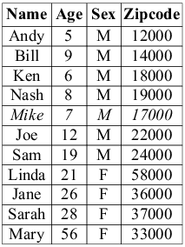
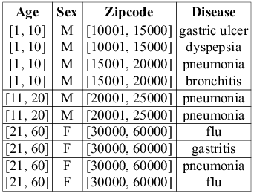
Privacy principle 1: k-anonymity your quasi-identifiers are indistinguishable from ≥ k other people’s.
[Sweeney, Int’l J. on Uncertainty, Fuzziness and Knowledge-based Systems, 2002]
Sensitive attribute
2-anonymous generalization:
QI attributes
A voter registration list
4 QI groups

Slide 30

The biggest advantage of k-anonymity is that people can understand it.
And often it can be computed fast.
But in general, it is easy to attack.

Slide 31
k-anonymity ... or how not to define privacy.
[Shmatikov]
Does not say anything about the computations to be done on the data (utility).
Assumes that attacker will be able to join only on quasi-identifiers.
Intuitive reasoning:
k-anonymity prevents attacker from telling which record corresponds to which person.
Therefore, attacker cannot tell that a certain person has a particular value of a sensitive attribute.
This reasoning is fallacious!

Slide 32
k-anonymity does not provide privacy if the sensitive values in an equivalence class lack diversity, or the attacker has certain background knowledge.
From a voter registration list
A 3-anonymous patient table
Homogeneity Attack
Zipcode | Age | Disease
476** | 2* | Heart Disease
476** | 2* | Heart Disease
476** | 2* | Heart Disease
4790* | ≥40 | Flu
4790* | ≥40 | Heart Disease
4790* | ≥40 | Cancer
476** | 3* | Heart Disease
476** | 3* | Cancer
476** | 3* | Cancer
Bob
Zipcode | Age
47678 | 27
Background Knowledge Attack
Carl
Zipcode | Age
47673 | 36

Slide 33
Updates can also destroy k-anonymity.
What is Joe’s disease? Wait for his birthday.
A voter registration list
plus dates of birth (not shown)
No “diversity” in this QI group.
10
17000

Slide 34
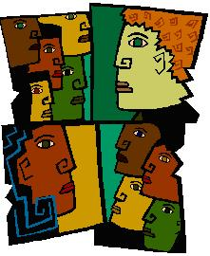
Principle 2: l-diversity
[Machanavajjhala et al., ICDE, 2006]
Each QI group should have at least l “well-represented” sensitive values.

Slide 35
Maybe each QI-group must have l different sensitive values?
A 2-diverse table
Age | Sex | Zipcode | Disease
[1, 5] | M | [10001, 15000] | gastric ulcer
[1, 5] | M | [10001, 15000] | dyspepsia
[6, 10] | M | [15001, 20000] | pneumonia
[6, 10] | M | [15001, 20000] | bronchitis
[11, 20] | F | [20001, 25000] | flu
[11, 20] | F | [20001, 25000] | pneumonia
[21, 60] | F | [30001, 60000] | gastritis
[21, 60] | F | [30001, 60000] | gastritis
[21, 60] | F | [30001, 60000] | flu
[21, 60] | F | [30001, 60000] | flu

Slide 36
We can attack this probabilistically.
If we know Joe’s QI group, what is the probability he has HIV?
98 tuples
A QI group with 100 tuples
The conclusion researchers drew: The most frequent sensitive value in a QI group cannot be too frequent.

Slide 37
Even then, we can still attack using background knowledge.
Joe has HIV.
Sally knows Joe does not have pneumonia.
Sally can guess that Joe has HIV.
50 tuples
A QI group with 100 tuples
49 tuples

Slide 38
l-diversity variants have been proposed to address these weaknesses.
Probabilistic l-diversity
  The frequency of the most frequent value in an equivalence class is bounded by 1/l.
Entropy l-diversity
  The entropy of the distribution of sensitive values in each equivalence class is at least log(l)
Recursive (c,l)-diversity
  The most frequent value does not appear too frequently
  r₁<c(r_{l}+r_{l+1}+…+r_{m}), where r_{i} is the frequency of the i-th most frequent value.
When you see patches upon patches upon patches, it is a sign that a completely different approach is needed… like Jim Gray’s theory of transactions, versus how concurrency was previously handled.

Slide 39
(c=1, l=4) diversity example:
If Sally eliminates ≤ 3 diseases, she can guess Joe’s disease with at most 50% probability.
Same
cardinality
The most frequent value
The 2nd most frequent value
QI group
The 3rd most frequent value
The 4th most frequent value
Same
cardinality
The other values

Slide 40
(c, l)-diversity: If Sally can eliminate only l – 1 sensitive values, she can infer Joe’s disease with probability at most 1 / (c + 1).
r₁ tuples
r₁ ≤ c (r_{l} + … + r_{m})
QI
group
with
m
sensitive
values
r₂ tuples
r₃ tuples
r₄ tuples
…
r_{m} tuples

Slide 41
l-diversity can be overkill or underkill.
Original data
Anonymization A
Anonymization B
… | Cancer
… | Cancer
… | Cancer
… | Flu
… | Cancer
… | Cancer
… | Cancer
… | Cancer
… | Cancer
… | Cancer
… | Flu
… | Flu
Q1 | Flu
Q1 | Flu
Q1 | Cancer
Q1 | Flu
Q1 | Cancer
Q1 | Cancer
Q2 | Cancer
Q2 | Cancer
Q2 | Cancer
Q2 | Cancer
Q2 | Cancer
Q2 | Cancer
Q1 | Flu
Q1 | Cancer
Q1 | Cancer
Q1 | Cancer
Q1 | Cancer
Q1 | Cancer
Q2 | Cancer
Q2 | Cancer
Q2 | Cancer
Q2 | Cancer
Q2 | Flu
Q2 | Flu
99% cancer ⇒ quasi-identifier group is not “diverse”, yet anonymized database does not leak much new info.
50% cancer ⇒ quasi-identifier group is “diverse”
This leaks a ton of new information
99% have cancer
Diversity does not inherently benefit privacy.

Slide 42
(c,l)-diversity does not consider personal preferences with respect to anonymization…
Andy does not want anyone to know that he had a stomach problem.
Sarah does not mind at all if others find out that she had flu.
A 2-diverse table
A voter registration list
Age | Sex | Zipcode | Disease
[1, 5] | M | [10001, 15000] | gastric ulcer
[1, 5] | M | [10001, 15000] | dyspepsia
[6, 10] | M | [15001, 20000] | pneumonia
[6, 10] | M | [15001, 20000] | bronchitis
[11, 20] | F | [20001, 25000] | flu
[11, 20] | F | [20001, 25000] | pneumonia
[21, 60] | F | [30001, 60000] | gastritis
[21, 60] | F | [30001, 60000] | gastritis
[21, 60] | F | [30001, 60000] | flu
[21, 60] | F | [30001, 60000] | flu
Name | Age | Sex | Zipcode
Andy | 4 | M | 12000
Bill | 5 | M | 14000
Ken | 6 | M | 18000
Nash | 9 | M | 19000
Mike | 7 | M | 17000
Alice | 12 | F | 22000
Betty | 19 | F | 24000
Linda | 21 | F | 33000
Jane | 25 | F | 34000
Sarah | 28 | F | 37000
Mary | 56 | F | 58000

Slide 43
l-diversity can be hard to achieve.
  2-diversity is overkill for groups in the green area
  To have distinct 2-diversity for 10,000 HIV records, there can be at most 10000*1%=100 equivalence classes (difficult to achieve without compromising utility)
QI attributes | HIV status
99%
of tuples
(not sensitive)
1%
of tuples
(sensitive)

Slide 44
l-diversity does not work well if an individual can have multiple tuples in the microdata.
Microdata
Name | Age | Sex | Zipcode | Disease
Andy | 4 | M | 12000 | gastric ulcer
Andy | 4 | M | 12000 | dyspepsia
Ken | 6 | M | 18000 | pneumonia
Nash | 9 | M | 19000 | bronchitis
Alice | 12 | F | 22000 | flu
Betty | 19 | F | 24000 | pneumonia
Linda | 21 | F | 33000 | gastritis
Jane | 25 | F | 34000 | gastritis
Sarah | 28 | F | 37000 | flu
Mary | 56 | F | 58000 | flu

Slide 45
A 2-diverse table
A voter registration list
Age | Sex | Zipcode | Disease
4 | M | 12000 | gastric ulcer
4 | M | 12000 | dyspepsia
[6, 10] | M | [15001, 20000] | pneumonia
[6, 10] | M | [15001, 20000] | bronchitis
[11, 20] | F | [20001, 25000] | flu
[11, 20] | F | [20001, 25000] | pneumonia
[21, 60] | F | [30001, 60000] | gastritis
[21, 60] | F | [30001, 60000] | gastritis
[21, 60] | F | [30001, 60000] | flu
[21, 60] | F | [30001, 60000] | flu
Name | Age | Sex | Zipcode
Andy | 4 | M | 12000
Ken | 6 | M | 18000
Nash | 9 | M | 19000
Mike | 7 | M | 17000
Alice | 12 | F | 22000
Betty | 19 | F | 24000
Linda | 21 | F | 33000
Jane | 25 | F | 34000
Sarah | 28 | F | 37000
Mary | 56 | F | 58000

Slide 46
Principle 3: t-Closeness
[Li et al. ICDE ‘07]
Caucas | 787XX | Flu
Caucas | 787XX | Shingles
Caucas | 787XX | Acne
Caucas | 787XX | Flu
Caucas | 787XX | Acne
Caucas | 787XX | Flu
Asian/AfrAm | 78XXX | Flu
Asian/AfrAm | 78XXX | Flu
Asian/AfrAm | 78XXX | Acne
Asian/AfrAm | 78XXX | Shingles
Asian/AfrAm | 78XXX | Acne
Asian/AfrAm | 78XXX | Flu
Distribution of sensitive
attributes within each
quasi-identifier group should be “close” to their distribution in the entire original DB

Slide 47
Then we can bound the knowledge that the attacker gains by seeing a particular anonymization.
Adversarial belief
Released table
Age | Zip code | …… | Gender | Disease
2* | 479** | …… | Male | Flu
2* | 479** | …… | Male | Heart Disease
2* | 479** | …… | Male | Cancer
. . . | . . . | …… …… …… | . . . | . . .
≥50 | 4766* | …… | * | Gastritis
Belief | Knowledge
B₀
External
Knowledge
B₁
Overall distribution of sensitive values
B₂
Distribution of sensitive values in a particular group
Only applicable when we can define the distance between values, e.g., using a hierarchy of diagnoses.

Slide 48
How can we measure the distance between two distributions?
  Q: {3, 4, 5, 6, 7, 8, 9, 10, 11}
  P₁: {3, 4, 5}
  P₂: {6, 8, 11}
  Intuitively, Q is closer to P₂ than P₁ .

Slide 49
Earth Mover’s Distance: the minimum amount of work to move the “earth” of one distribution to make it look like another.
Define the cost of moving d values from bin to i to bin j as:

Slide 50
Earth Mover’s Distance formalization
Given distributions X={x₁,…,x_{n}} and Y={y₁,…,y_{n}}, set c_{ij}=|i-j| and find the values for f_{ij} that minimize:
subject to the constraints:
c_{ij}= cost of moving from bin i to bin j
f_{ij}= amount of data moved from bin i to bin j

Slide 51
Earth Mover’s Distance salary example
  {3k,4k,5k} and {3k,4k,5k,6k,7k,8k,9k,10k,11k}
  Move 1/9 probability for each of the following pairs:
    3k->6k,3k->7k cost: 1/9*(3+4)/8
    4k->8k,4k->9k cost: 1/9*(4+5)/8
    5k->10k,5k->11k cost: 1/9*(5+6)/8
  Total cost: 1/9 * 27/8 = 0.375 = t
  For {6k, 8k,11k}, the cost is t = 0.167 < 0.375.
Only applicable when we can define the distance between values, e.g., using a hierarchy of diagnoses.

Slide 52
How anonymous is this 4-anonymous, 3-diverse, and perfectly-t-close data?
Asian/AfrAm | 787XX | HIV- | Acne
Asian/AfrAm | 787XX | HIV- | Acne
Asian/AfrAm | 787XX | HIV- | Flu
Asian/AfrAm | 787XX | HIV+ | Shingles
Caucasian | 787XX | HIV+ | Flu
Caucasian | 787XX | HIV- | Acne
Caucasian | 787XX | HIV- | Shingles
Caucasian | 787XX | HIV- | Acne

Slide 53
That depends on the attacker’s background knowledge.
My coworker Bob’s shingles got so bad that he is in the hospital. He looks Asian to me…
Asian/AfrAm | 787XX | HIV- | Acne
Asian/AfrAm | 787XX | HIV- | Acne
Asian/AfrAm | 787XX | HIV- | Flu
Asian/AfrAm | 787XX | HIV+ | Shingles
Caucasian | 787XX | HIV+ | Flu
Caucasian | 787XX | HIV- | Acne
Caucasian | 787XX | HIV- | Shingles
Caucasian | 787XX | HIV- | Acne
This is against the rules, because
flu is not a quasi-identifier.
In the real world, almost anything could be personally identifying (as we saw with Netflix).

Slide 54
There are probably 100 other related proposed privacy principles…
k-gather, (a, k)-anonymity, personalized anonymity, positive disclosure-recursive (c, l)-diversity, non-positive-disclosure (c1, c2, l)-diversity, m-invariance, (c, t)-isolation, …
And for other data models, e.g., graphs:
k-degree anonymity, k-neighborhood anonymity, k-sized grouping, (k, l) grouping, …

Slide 55
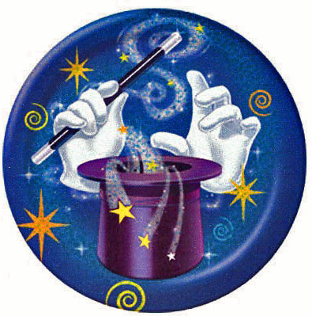
… and they suffer from related problems. [Shmatikov]
Trying to achieve “privacy” by
syntactic transformation of the data
- Scrubbing of PII, k-anonymity, l-diversity…
Fatally flawed!
Insecure against attackers with arbitrary background info
Do not compose (anonymize twice ⇒ reveal data)
No meaningful notion of privacy
No meaningful notion of utility
Does he go too far?

Slide 56
And there is an impossibility result that applies to all of them. [Dwork, Naor 2006]
For any reasonable definition of “privacy breach” and “sanitization”, with high probability some adversary can breach some sanitized DB.
Example:
  Private fact: my exact height
  Background knowledge: I’m 5 inches taller than the average American woman
  San(DB) allows computing average height of US women
  This breaks my privacy … even if my record is not in the database!

Slide 57
(Very Informal) Proof Sketch
Suppose DB is uniformly random
  Entropy I( DB ; San(DB) ) > 0
“Breach” is predicting a predicate g(DB)
Adversary knows r, H(r ; San(DB)) ⊕ g(DB)
  H is a suitable hash function, r=H(DB)
By itself, does not leak anything about DB
Together with San(DB), reveals g(DB)

Slide 58
How to do it right (according to Shmatikov)
Privacy is not a property of the data.
  Syntactic definitions are doomed to fail!
Privacy is a property of the analysis carried out on the data.
  Marianne says: don’t forget the identity transformation.
The definition of privacy must be robust in the presence of arbitrary background information.

Slide 59
Principle 4: differential privacy
An analysis result should not change much,
whether or not any single individual’s record is in the DB
C should be no worse off for having her record in the analysis.

Slide 60
Differential privacy definition [Dwork 2006]
A query-answering method A is ε-differentially private if for all data sets D1 and D2 differing by at most one element and all (one-time) queries Q and possible answers R,
Pr[A(Q, D1) = R ] ≤ e^{ε} Pr[A(Q, D2) = R ].
e^{-ε} ≤ ≤ e^{ε}
Pr[A(Q, D2) = R ]
≈ 1+ε, when ε ≤ .1
≈ 1-ε, when ε ≤ .1

Slide 61

To attain DP, add noise to the analysis result.
User
q?
q(DB) + noise(q)
DB
Intuitively, the more sensitive q is to DB’s content, the more noise you need.
Sensitivity is a worst case measure: “global sensitivity”
Sensitivity is independent of DB’s current content.

Slide 62
Background knowledge could be everything but this one record, and DP will still protect it.
User
q?
q(DB) + noise(q)
DB
Examples:
Sensitivity of “how many people aged 21 have diabetes” is 1.
Sensitivity of sum, avg, max, min medical bill is very high.

Slide 63
Usually, set noise(q) ≡ Lap(sensitivity(q)/ε).
Take a random sample from Laplace distribution with parameter λ,
λ = sensitivity(q)/ε.
mean = 0, variance = 2 λ², Pr(x) = e^{–|x|/λ} = e ^{–ε|x|/sens(q)}
… -7 -6 -5 -4 -3 -2 -1 0 1 2 3 4 5 6 7 …

Slide 64
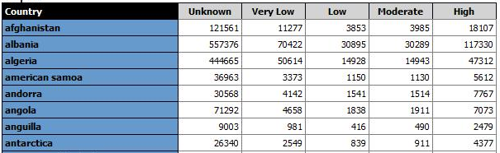
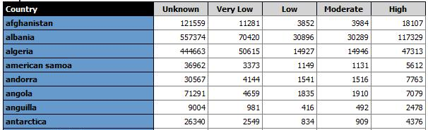
Microsoft’s Windows Live example report [Lee, 200X]
Notes:
For example, reviewing the country Afghanistan, the “Unknown” value is 121561 in one case and 121599 in another. Because of the random noise, we do not know what the “real” value is.

Slide 65
Microsoft Web Analytics Group’s feedback
Rollup total mismatch looked like dirty data
Country | Visitors
United States | 202
Canada | 31
Country | Gender | Visitors
United States | Female | 128
 | Male | 75
 | Total | 203
Canada | Female | 15
 | Male | 15
 | Total | 30
Easy to reconcile totals and reduce noise [Hay 2010, Ding 2011]

Slide 66
Results of analysis can be freely shared/published, and the guarantee still holds.
(but epsilon should have been set at a level intended for this)

